Slide 1
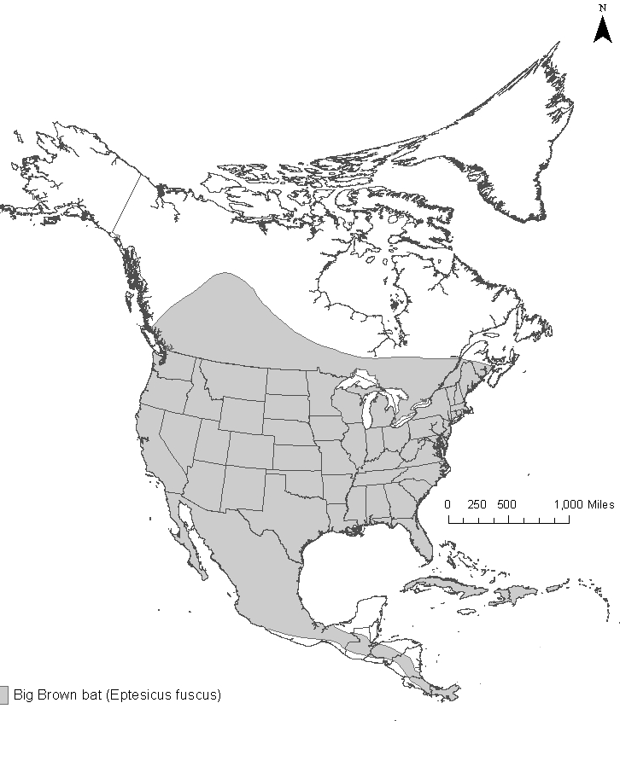
Neighborhood Bats – Predicting Species Occurrence
Educators and students: you are welcome to use the images in this presentation in schools or other educational venues. The photos are the ownership of many individuals and should not be used outside of this presentation without written permission. For such use, please contact Cynthia Sandeno at cmsandeno@fs.fed.us. These images should never be used or released for commercial use (for profit).

Slide 2
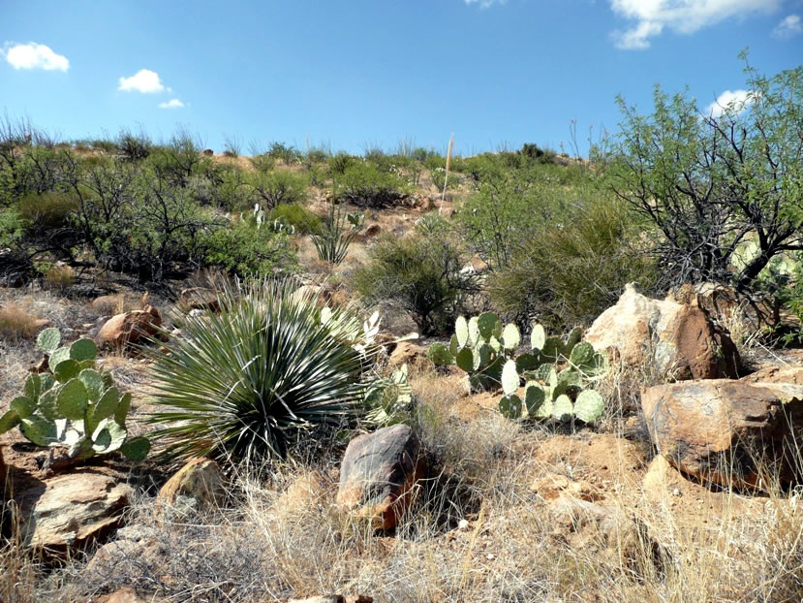
Major North American Habitats - Deserts
Photo by Charlie McDonald
Notes:
Deserts are habitats that receive very little rain (typically less than 10 inches a year). Deserts not only have low rainfall, they also are characterized by a high rate of water loss from the ground (evaporation) and through plants (transpiration). About 1/3 of the Earth’s land surface is desert. These arid regions are called deserts because they are dry. They may be hot or cold.
You can see several cacti and thorny bushes in this photo. Much of the southwestern United States is arid. The Desert Southwest includes the warm deserts of California, Arizona, New Mexico, and Texas.

Slide 3
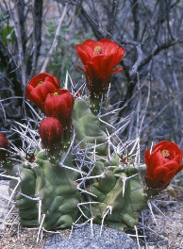
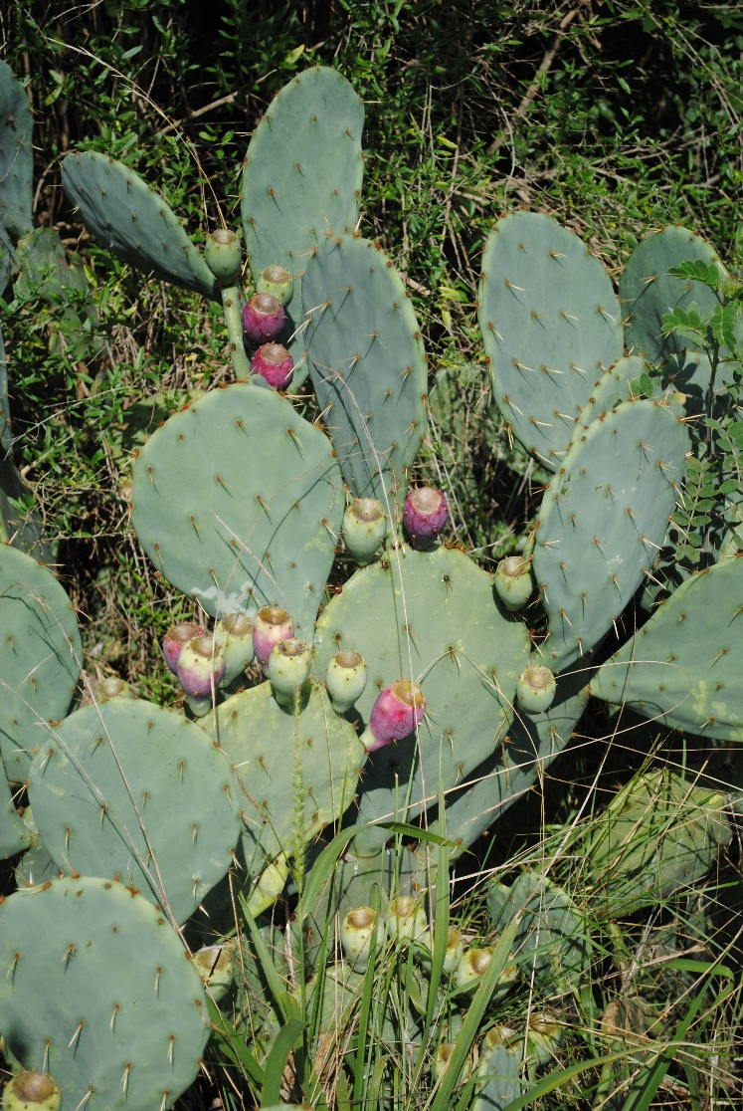
Major North American Habitats - Deserts
Photo by Charlie McDonald
Photo by Robert Sivinski, CalPhotos
Photo by Cynthia Sandeno, US Forest Service
Notes:
Cacti are a common sight in deserts. Pictured on the left is a kingcup cactus (Echinocereus triglochidiatus). Photo by Robert Sivinski, CalPhotos. On the right is a prickly pear cactus (Opuntia sp.). Photo by Cynthia Sandeno, US Forest Service.
Cacti and other plants have developed special adaptations to be able to live in such arid habitats. Cacti have a thick waxy outer layer to keep all the water from evaporating. They also grow sharp needles and stickers to protect themselves against animals.

Slide 4
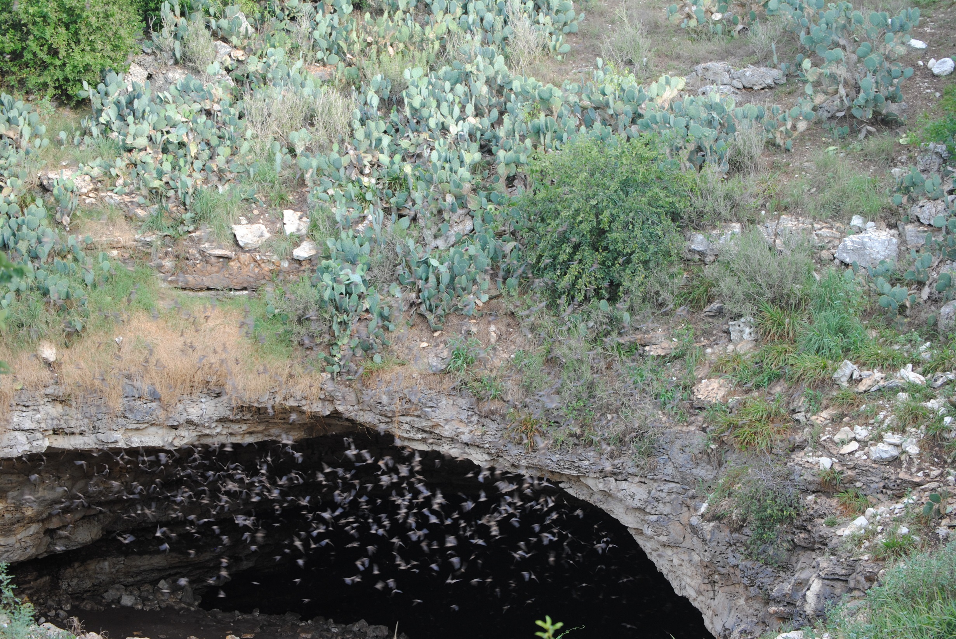
Major North American Habitats - Deserts
Photo by Cynthia Sandeno
Notes:
Bracken Cave, located just north of San Antonio, Texas, is home to about 15- 20 million Mexican free-tailed bats. You can see the bats starting to emerge from the cave entrance. Other animals of the southwest desert include collared lizards, fence lizards, rattlesnakes, scorpions, coyotes, and more. Photo by Cynthia Sandeno, US Forest Service.

Slide 5
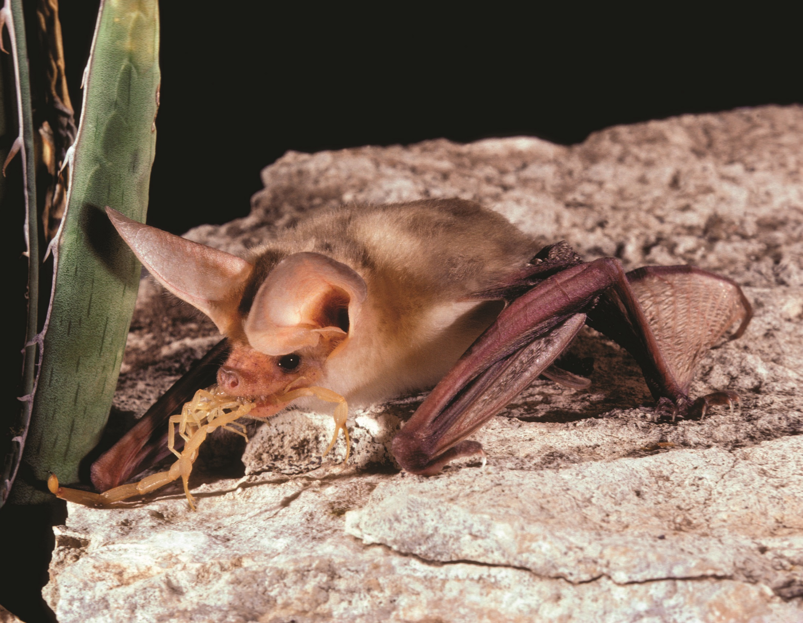
Pallid Bat
© Merlin D. Tuttle, Bat Conservation International
www.batcon.org
Notes:
The pallid bat can be found in . They feed on scorpions, centipedes, crickets, and a variety of other large, ground-dwelling insects. They pick their prey off the ground or off of vegetation. Because the pallid bat is not dependent on water for finding insects or for drinking, it can be found in more extreme desert habitats.

Slide 6
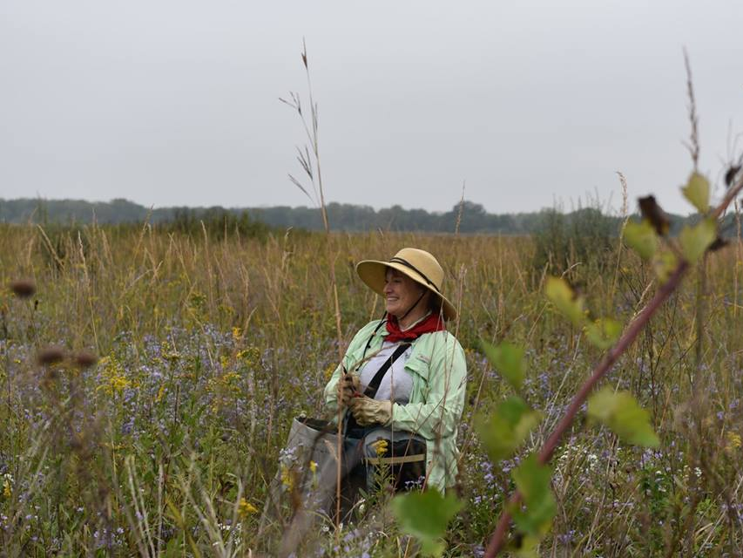
Major North American Habitats - Grasslands
Notes:
Grasslands are communities dominated by grasses. Shrubs and trees are usually absent. While grasslands were thought to cover about ¼ of the earth’s surface, less than 2% of native prairie remains today.

Slide 7
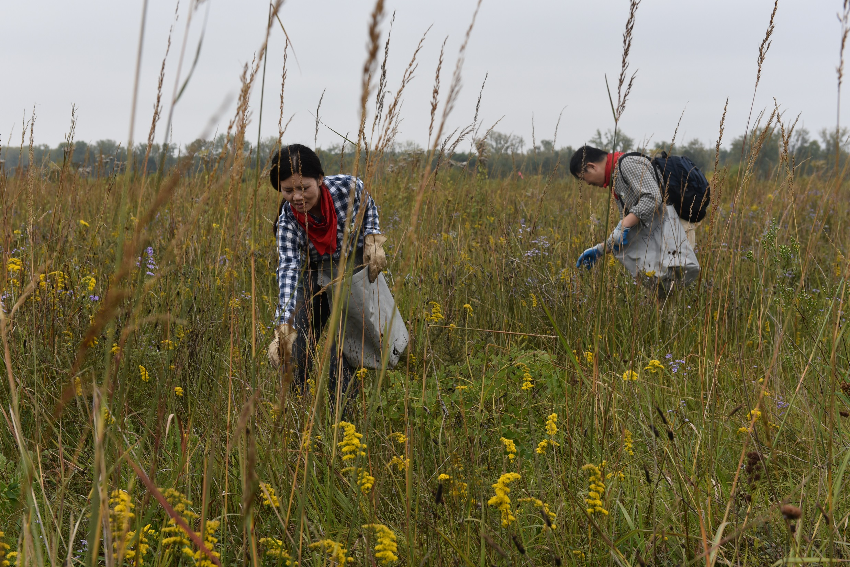
Major North American Habitats - Grasslands
Notes:
Grasslands are also called prairies which is a term that derives from a word French trappers and explorers gave to the sea of grass they encountered in the center of North America. Grasslands are very diverse habitats and containing many flowering plants.

Slide 8
Major North American Habitats - Grasslands
Notes:
Historically, grasslands were teeming with wildlife such as bison herds, elk, pronghorn antelope, prairie dogs, jackrabbits, and ground squirrels. In the Midwestern United States, grasslands are being restored. On the Midewin National Tallgrass Prairie, just south of Chicago, IL, Bison have recently been reintroduced to help manage the habitat (2016).

Slide 9
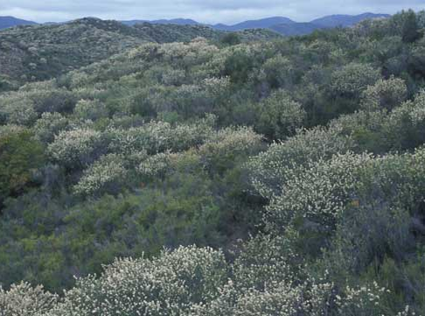
Major North American Habitats – Chaparral and Oak Woodlands
Photo by Charlie McDonald
Notes:
Chaparral is a plant community characterized by open, low-growing woody vegetation- usually shrubs and small trees. Chaparral is a semi-arid, shrub dominated community with dry-loving, woody plants that is shaped by summer drought, mild, wet winters, and infrequent fires. This habitat is found in lower northern, central, and southern California (west coast of the U.S.)
This is a photo of chaparral in the Trabuco Ranger District of the Cleveland National Forest.
California condor, spotted skunk, kangaroo rat, California gnatcatcher, and Yuma myotis are found in chaparral habitat.

Slide 10
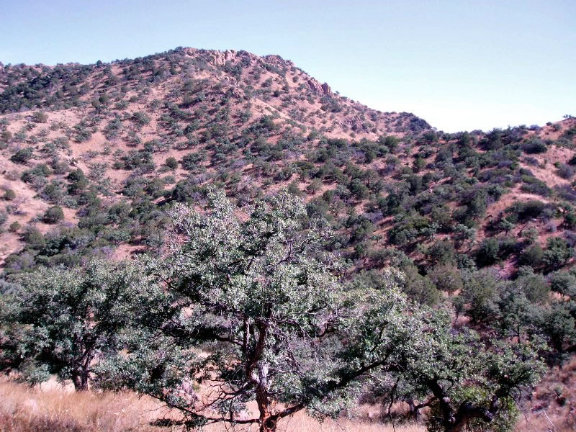
Major North American Habitats – Chaparral and Oak Woodlands
Notes:
Chaparral and Oak Woodlands are characterized by open, low-growing woody vegetation- usually shrubs and small trees. Shrub oak tend to dominate the lower elevations. You can see that the habitat becomes dominated by shrubs as you move up the mountain side. This is a photo of an open evergreen oak woodland in the Tumacacori Highlands. Most of these trees are less than 20 feet tall. Photo by Charlie McDonald.
This habitat is found in lower northern, central, and southern California (west coast of the U.S.)
Wildlife includes the white-eared pocket mouse, kangaroo rats, mountain lion, bobcat, and coyote. The monarch butterfly comes to this habitat during the winter months and settles around the coast.

Slide 11
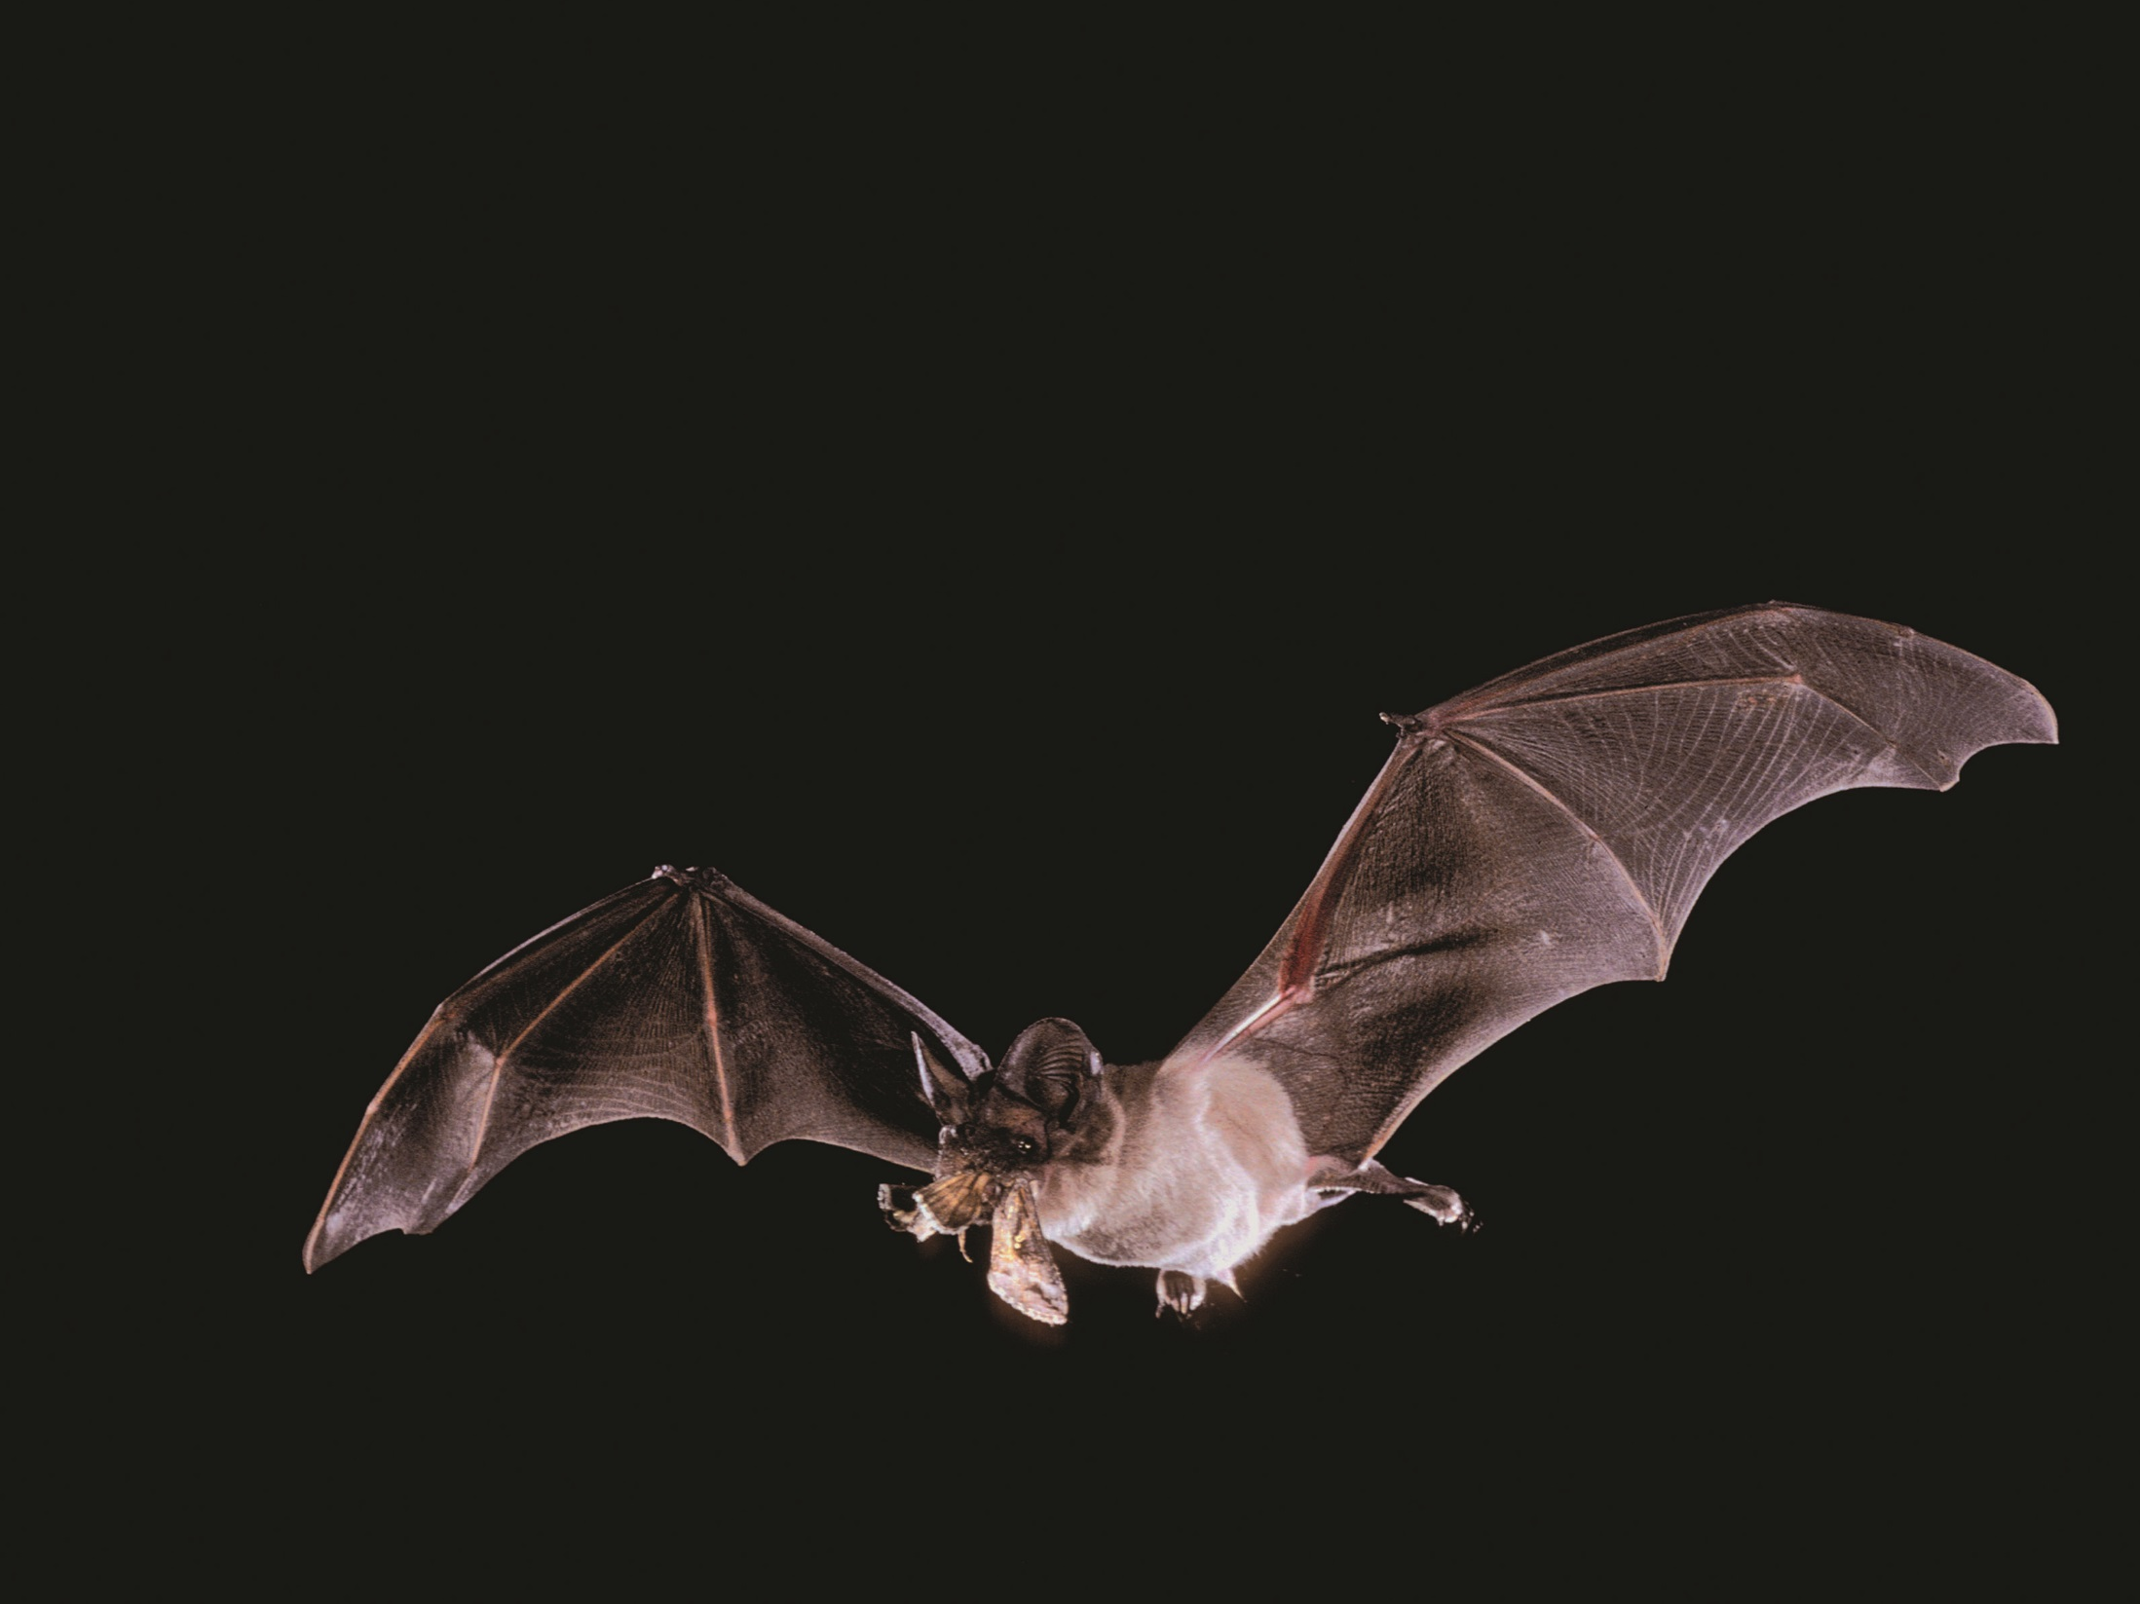
Mexican Free-tailed Bat
© Merlin D. Tuttle, Bat Conservation International
www.batcon.org
Notes:
Mexican free-tailed bats can be found in oak woodlands and chaparral habitats, as well as deserts. Mexican free-tailed bats love moths and catch their food in flight. They eat moths that can damage our crops like the corn borer moth. These bats can fly up to 10,000 feet high to feed or to catch a tailwind!

Slide 12
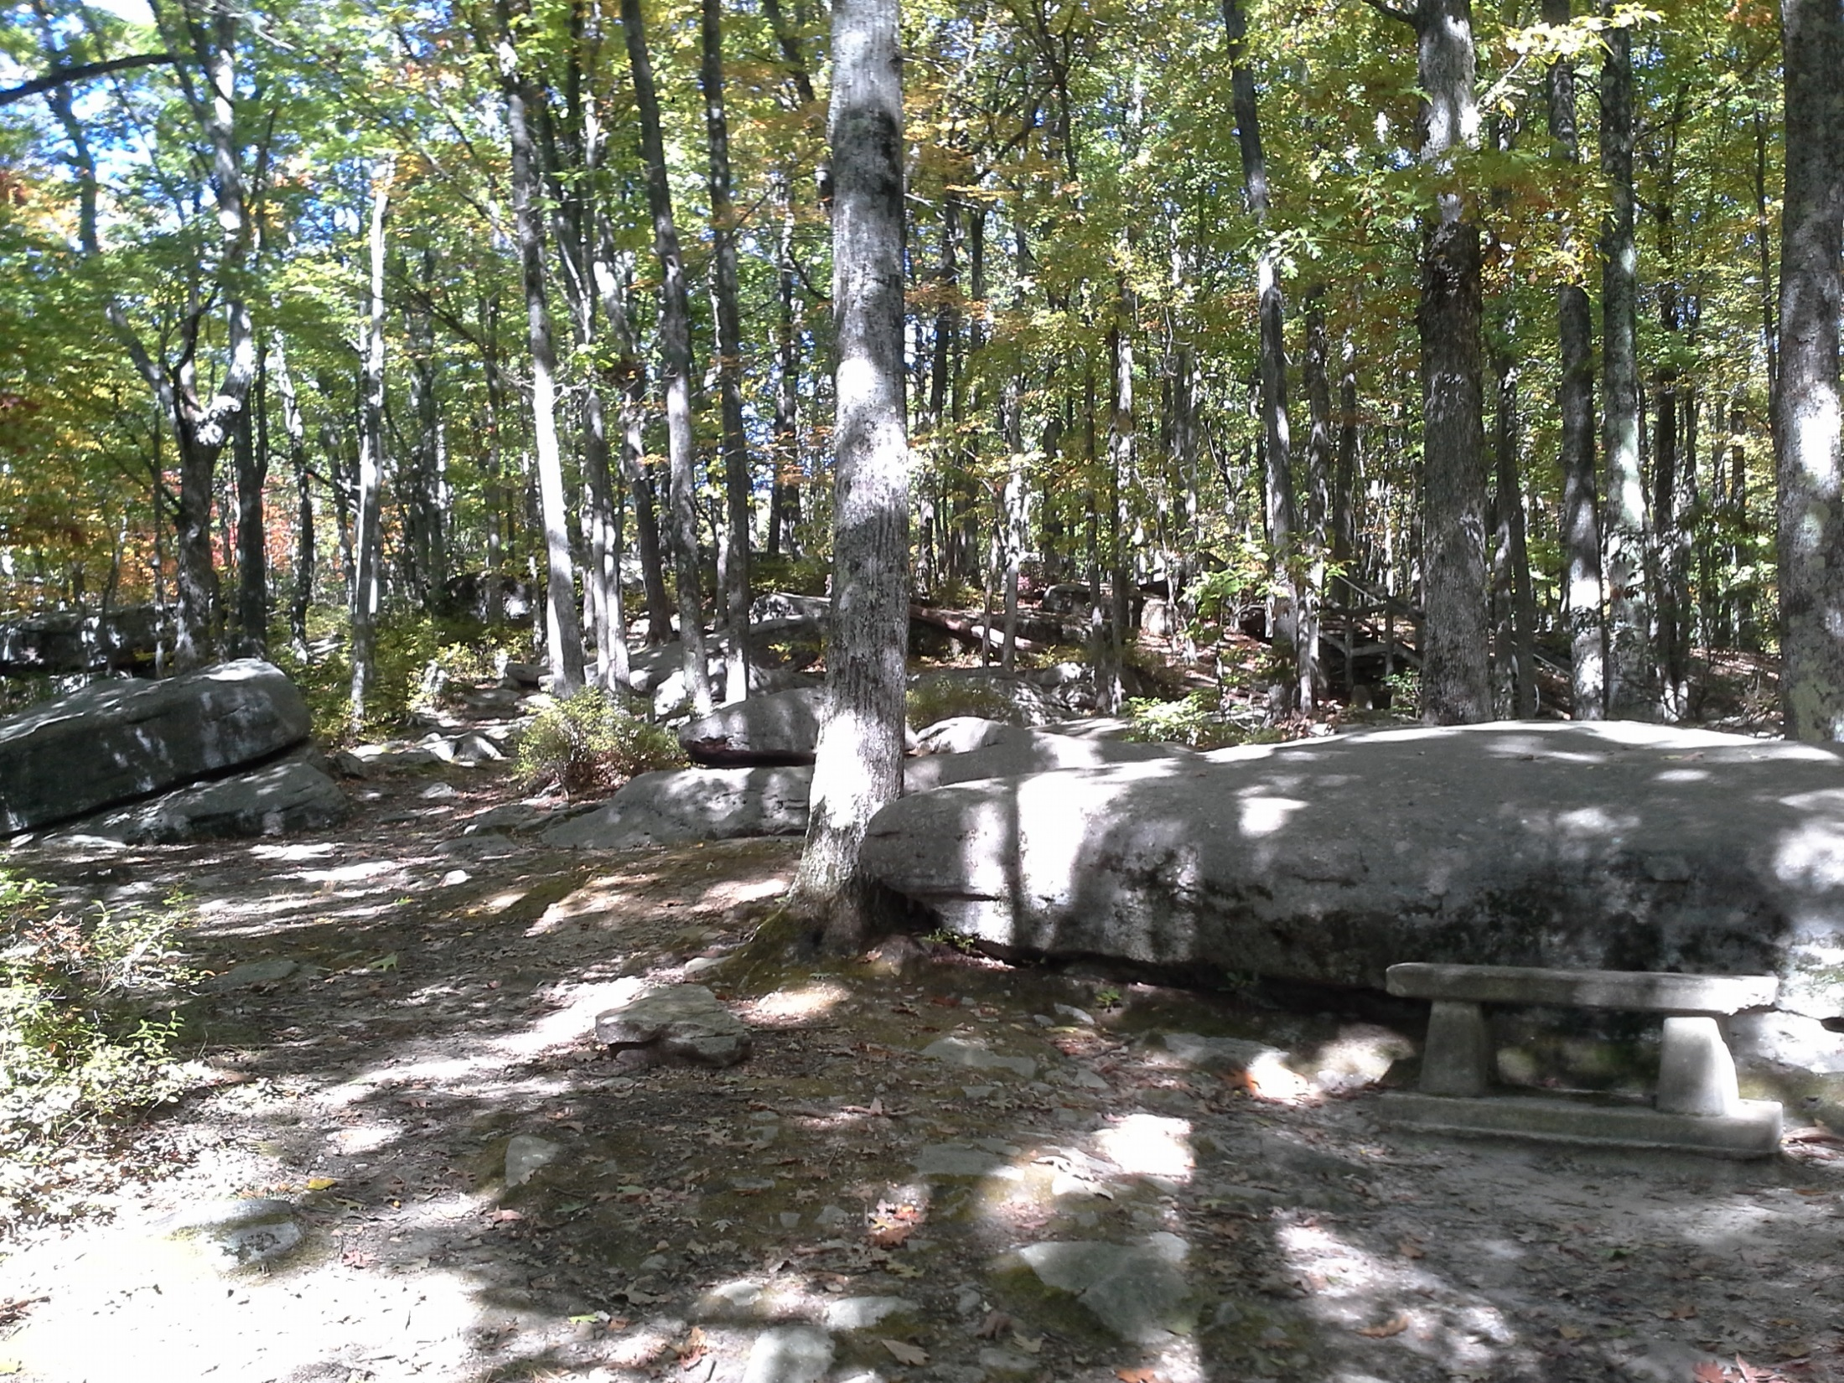
Major North American Habitats – Deciduous Forests
Notes:
The deciduous forest has four distinct seasons including spring, summer, fall, and winter. Deciduous forests can be found in the eastern half of North America.
These forests are dominated by broad-leafed trees that shed their leaves annually. The eastern deciduous forest is dominated by oaks, hickories, tulip poplar, American beech, and maples
Many animals have adapted to the climate by hibernating in the winter.

Slide 13
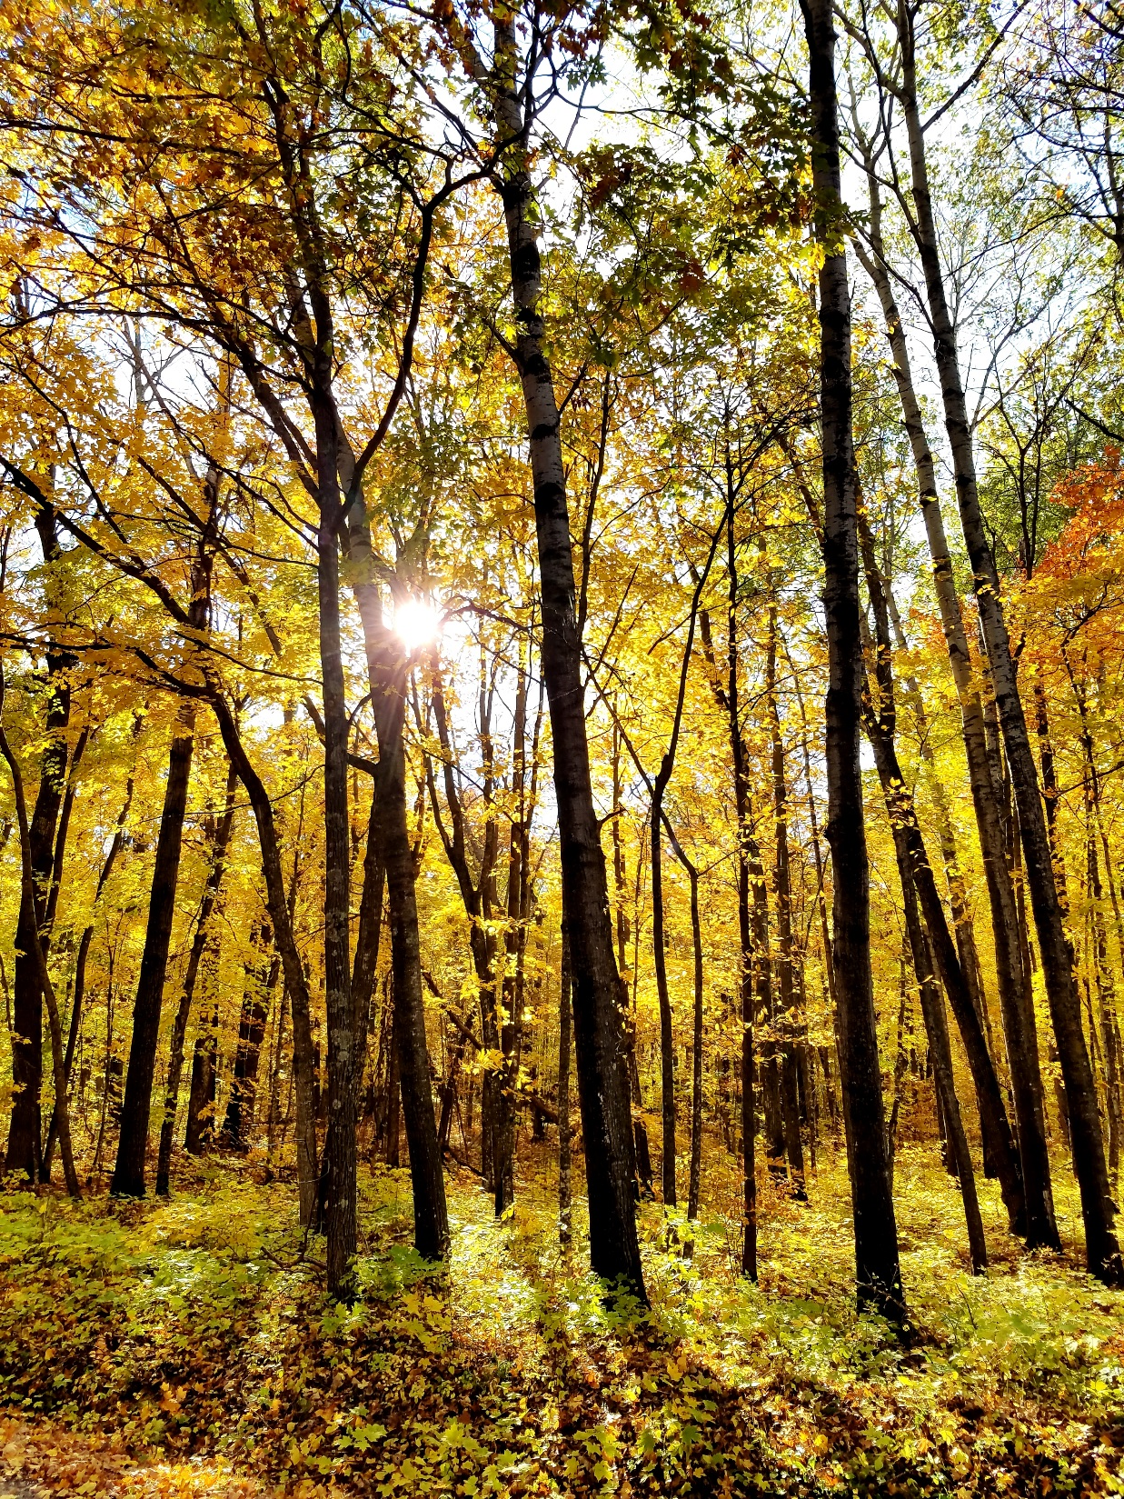
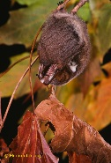
Major North American Habitats – Deciduous Forests
Notes:
In the fall, the leaves change their color and then fall from the tree as temperatures and precipitation drop. Photo by US Forest Service
Deciduous forests are very diverse. Animals that live in this habitat must be able to adapt to the changing seasons. Some animals in this habitat migrate or hibernate in the winter. Wildlife species include insects, spiders, frogs, turtles, hawks, eagles, owls, white-tailed deer, and more.
The red bat roosts in deciduous forests, hanging from branches. When the bat curls its wings around its body, it blends in well with the surrounding leaves.

Slide 14
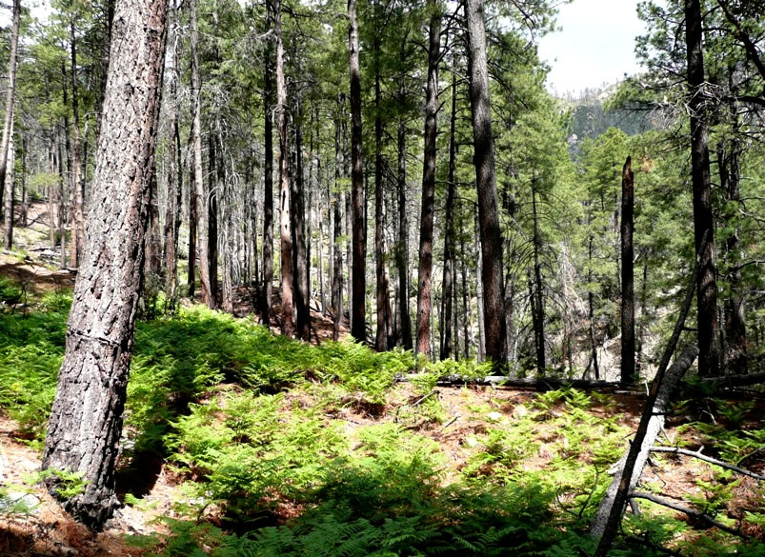
Major North American Habitats – Coniferous Forests
Notes:
In a coniferous forest, evergreen conifers dominate the vegetation, while some may be a mix of conifers and broadleaf deciduous trees. Many species of tree inhabit these forests such as pine, spruce, fir, cedar, and hemlock. Pine forests tend to have a closed canopy and relatively little understory vegetation. Brackenfern (Pteridium aquilinum) seen here is one plant that does well in dense pine forests. Photo by Charlie McDonald.

Slide 15
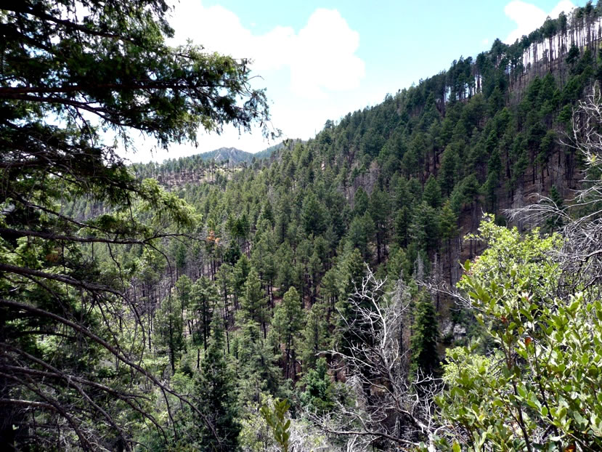
Major North American Habitats – Coniferous Forests
Photo by Charlie McDonald
Notes:
Some coniferous forests may be a mix of conifers and broadleaf deciduous trees. Coniferous forests are typically found in northern US and at higher elevations in mountains. A pine forest in the Pinaleno Mountains. Photo by Charlie McDonald.
Cool animals like shrews, voles, martens, moose, lynx, and wolves live in coniferous forests.

Slide 16
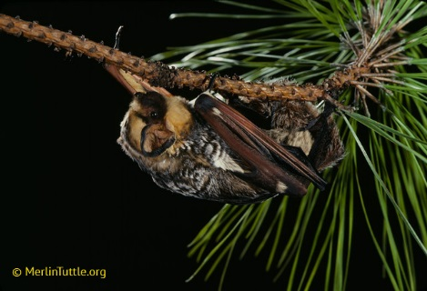
Notes:
The hoary bat uses both deciduous and coniferous forests. In this photo, a hoary bat is preparing to hang from the branch of a conifer. Look at that beautiful fur!

