Slide 1
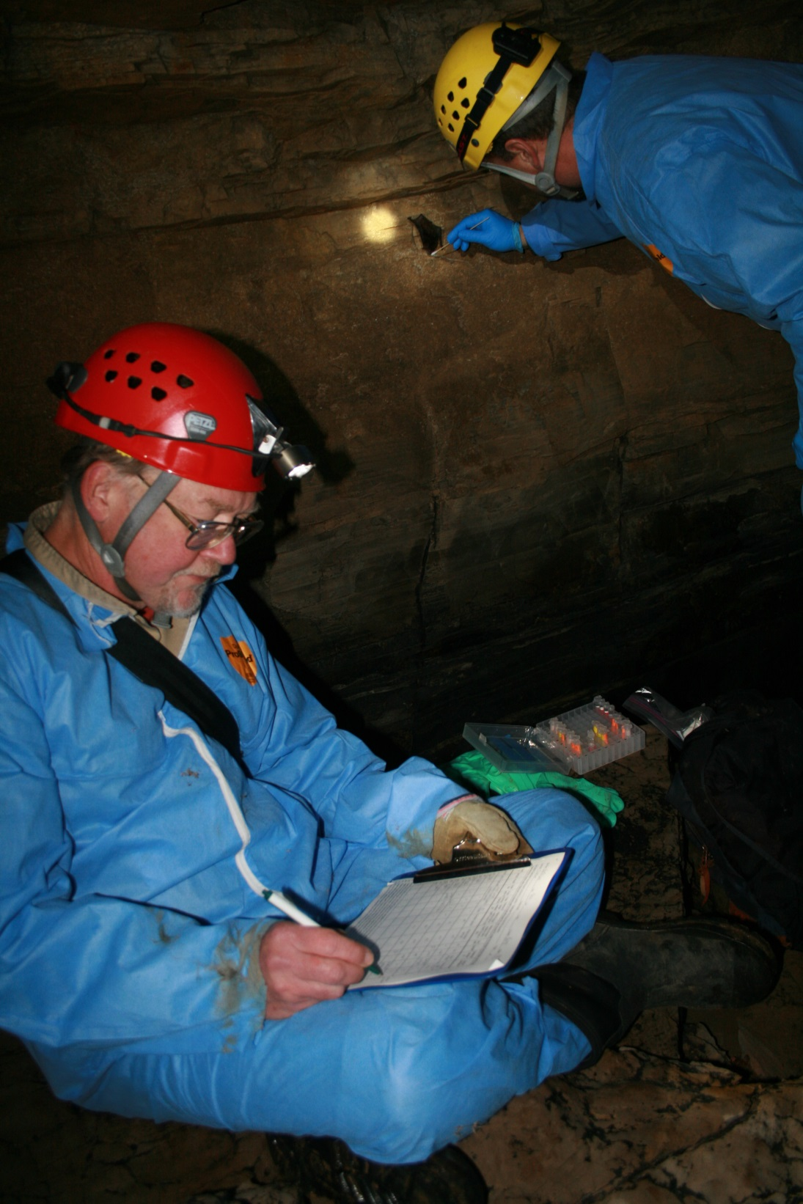
Working the Night Shift –
Biometric Clues
Educators and students: you are welcome to use the images in this presentation in schools or other educational venues. The photos are the ownership of many individuals and should not be used outside of this presentation without written permission. For such use, please contact Cynthia Sandeno at cmsandeno@fs.fed.us. These images should never be used or released for commercial use (for profit).
Photo by U.S. Fish and Wildlife Service

Slide 2
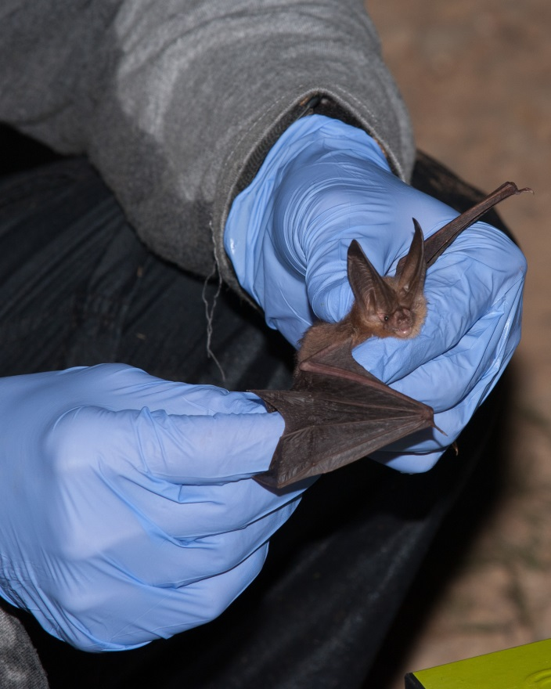
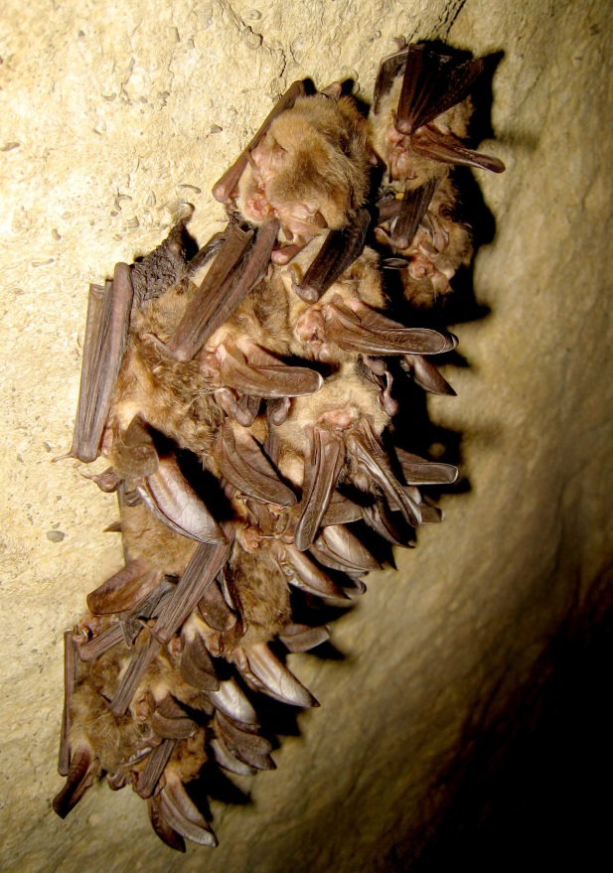
How Do Bat Biologists Identify Bat Species?
Photo by Tim Jones, U.S. Fish and Wildlife Service
Photo by Craig Stihler, West Virginia DNR
Notes:
How do bat biologists identify bat species?
How do you think bat biologists can determine a bat’s species? If you were going to collect data on a bat, what information would you need to help you determine a bat’s species? What data would you collect? How would you collect the data? Where would you go to collect your data? A river? A forest? Your backyard?
One of the ways bat biologists study bats is by catching them, collecting biometric data (measuring right forearm lengths, weighing bats, looking at the color of fur, etc.), making observations, and using that information to identify species.
(Bat pictured in the gloved hands of a biologist is a Virginia big-eared bat captured during mist netting in West Virginia. These bats cluster in groups as seen in the photo on the right also taken in West Virginia.)

Slide 3
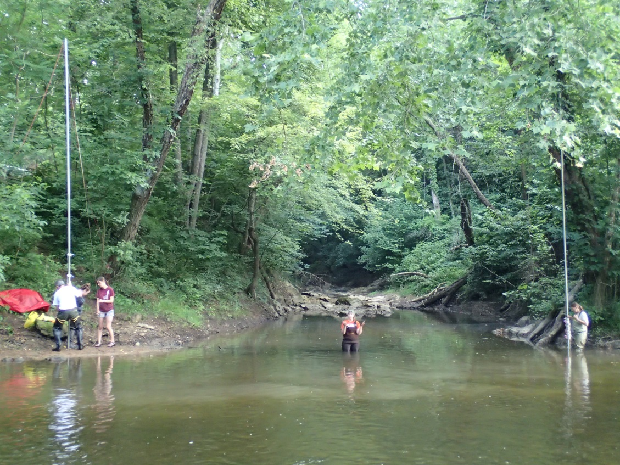
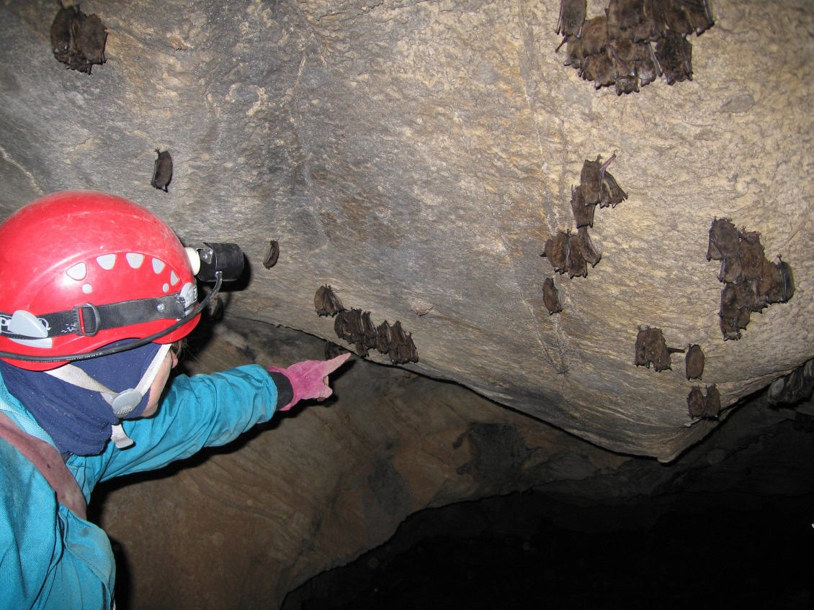
Where Do Bat Biologists Find Bats?
Over rivers and lakes
In caves
Under tree bark
Photo by Commonwealth of Virginia
Photo by Commonwealth of Virginia
Notes:
Where do bat biologists find bats?
Bats live in a wide variety of habitats. In the eastern United States, bat biologists look for bats near rivers and lakes where bats are hunting for insects or grabbing a drink of water. The top photo shows mist nets strung between two aluminum poles. Mist nets are usually made of nylon mesh suspended between two poles, resembling an oversized volleyball net. When properly set up, the nets are virtually invisible. You can’t see the net and neither can the bats! Bats can also be found in forests and caves.

Slide 4
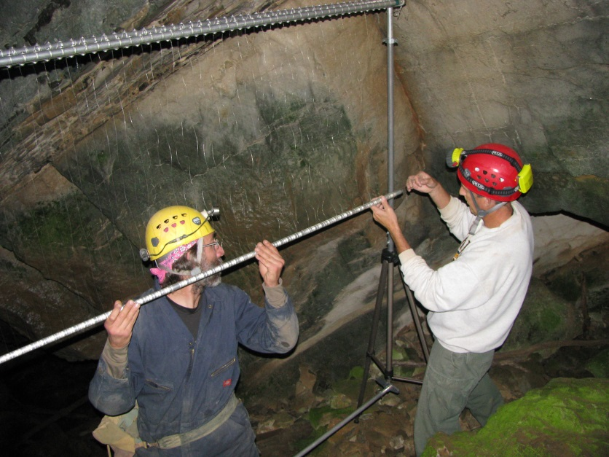
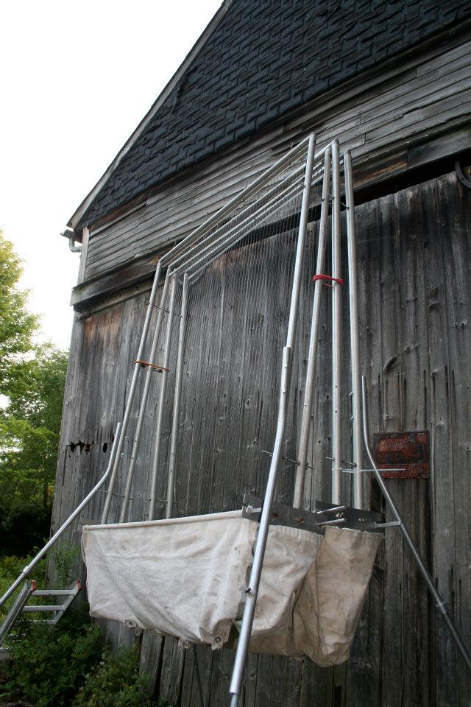
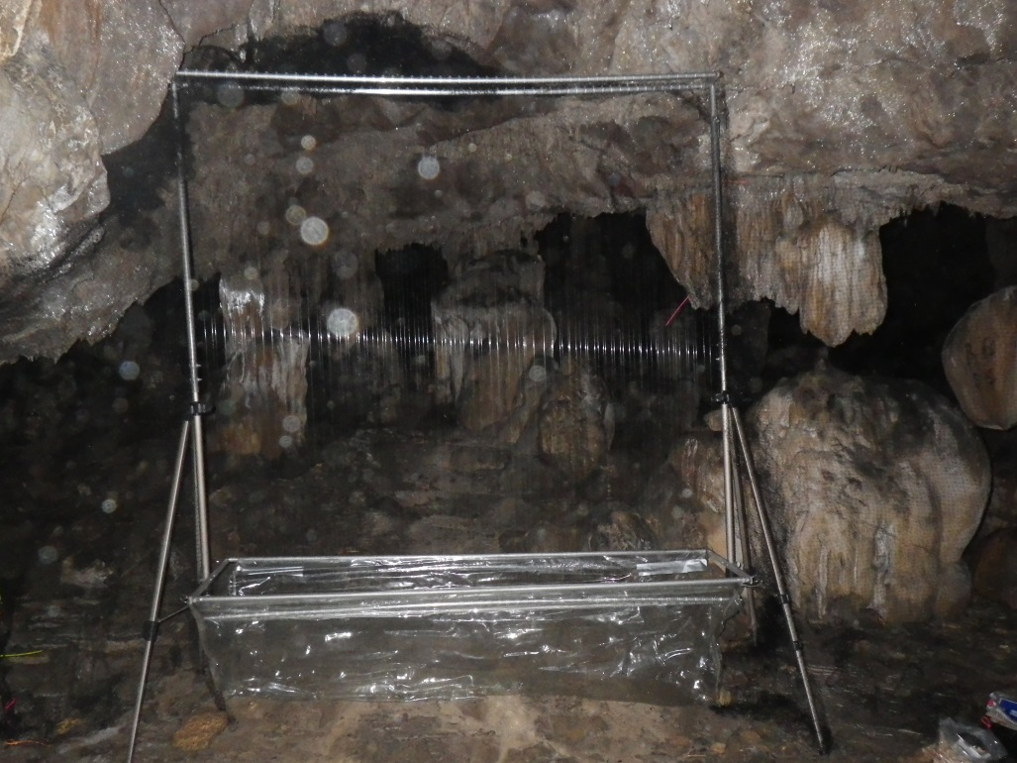
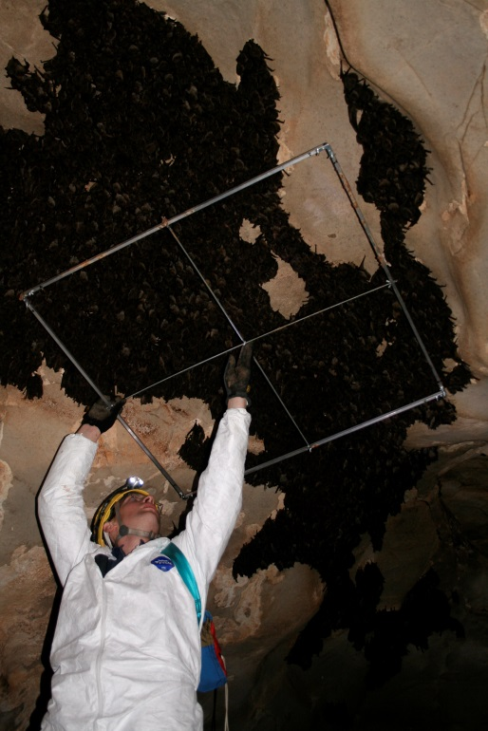
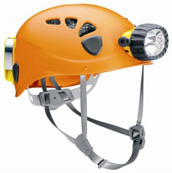
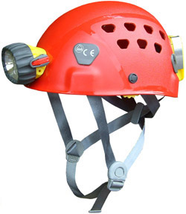
How Do Bat Biologists Catch Bats?
Mist nets
Harp traps
Visual Estimates
Photo by Commonwealth of Virginia
Photo by U.S. Fish and Wildlife Service
Photo by U.S. Fish and Wildlife Service
Photo © Karen Powers
Notes:
Catching bats
Bat biologists catch bats in mist nets and harp traps. Harp traps are a metal frame strung with vertical monofilament line (like fishing line) with a bag at the bottom. Bats drop down to the bottom of the trap and are easily removed by biologists.
If bats are roosting in a cave, biologists can also just gently take them off the walls or ceiling of the cave, or they may just make observations of the bats. Sometimes, biologists even count the number of bats by using grids. Because bat biologists usually work at night or in caves, they need special clothing and lights.
Top left photo is of biologists setting up a mist net at the mouth of a cave in Virginia. The right photo on the top is a harp trap set up outside a barn that contains a lot of bats.
The bottom left photo is a harp trap in a cave and the last photo is a biologist holding up a 1 meter grid to estimate the number of tightly clustered gray bats.

Slide 5
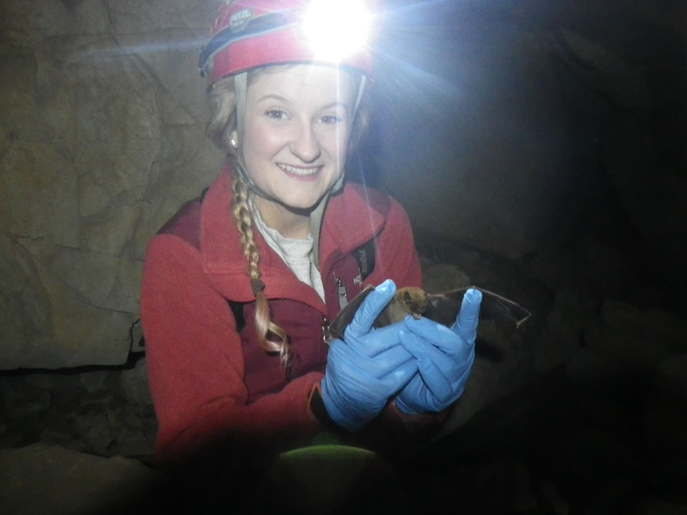
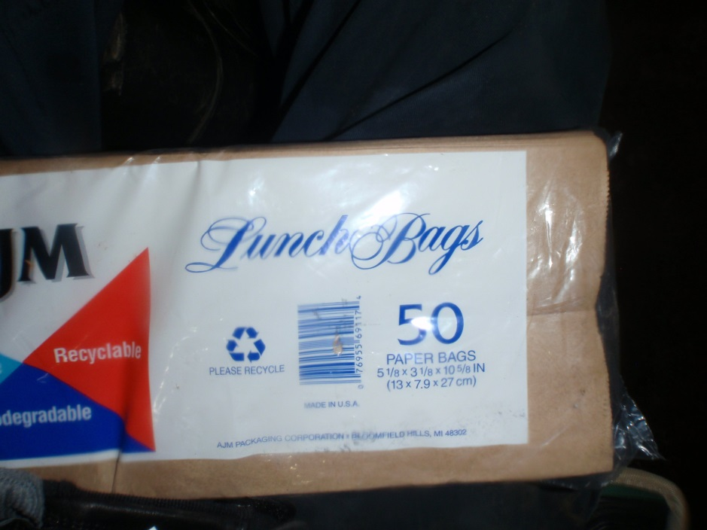
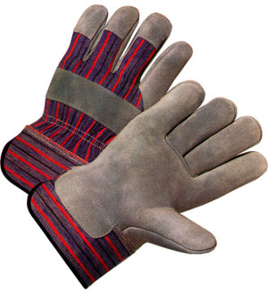
How Do Bat Biologists Handle Bats?
Always wear gloves to protect the biologist and the bats!
Bats can be stored in lunch bags for short periods of time.
Photo © Karen Powers
Photo by Commonwealth of Virginia
Notes:
Handling bats
Bats are small and have delicate wings. To minimize damaging bat wings, biologists have special training and experience. Bat biologists always wear gloves when handling bats to avoid transmitting diseases to the bats and to avoid being bitten by bats. You should NEVER handle wild animals unless you have proper equipment, training, and vaccinations.
Why are there pictures of lunch bags on this page? Biologists actually store bats in lunch bags to keep them calm while transporting bats short distances and when there are lots of bats to identify and measure. Lunch bags are inexpensive.

Slide 6
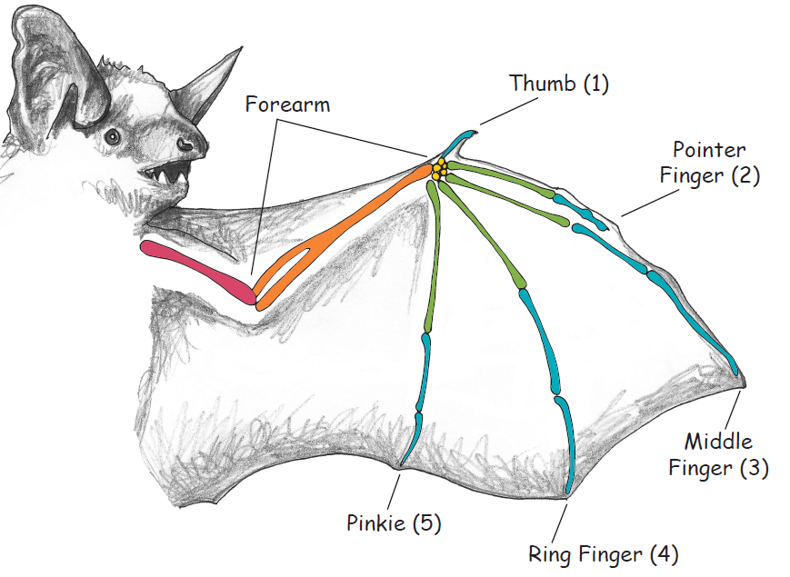
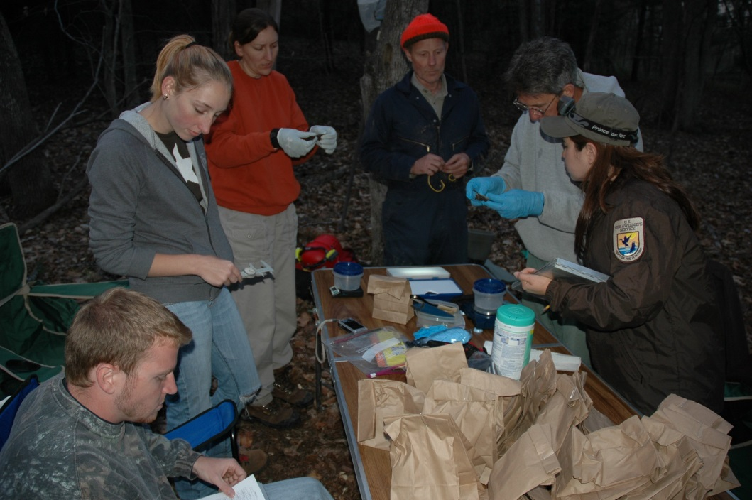
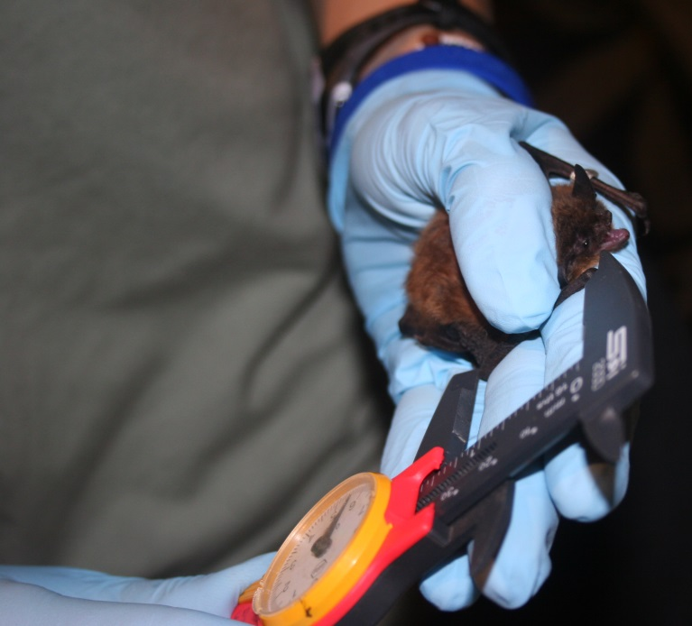
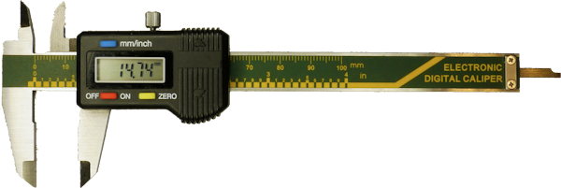
Biometric Measurements – Right Forearm
Photo by Commonwealth of Virginia
Photo by U.S. Fish and Wildlife Service
Notes:
Measuring the right forearm
It’s relatively easy for a trained biologist to hold a bat and extend the bat’s wing in order to measure the right forearm. The forearm of a bat is the small bone at the top of the wing membrane, between the elbow and the thumb. Using a caliper or ruler, a biologist measures the length of the bat’s right forearm, recording the data in millimeters.
Bat wings are one of the most remarkable features of a bat. A bat’s wing is actually a modified hand and the wing bones are elongated fingers. This elongation of the bones is required to support the wing membrane. Compare the bones of the wing to the fingers on a human hand. Also point out the thumb. The thumb has a small claw, which aids the bat in crawling around on rough surfaces.
Photo on top right – encourage your students to think about why there is a collection of bats.
Bottom photo – biologist measures the forearm of a little brown bat

Slide 7
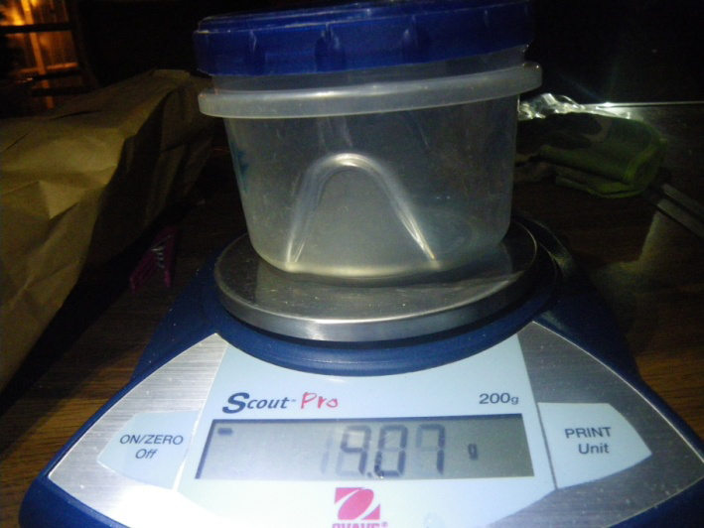
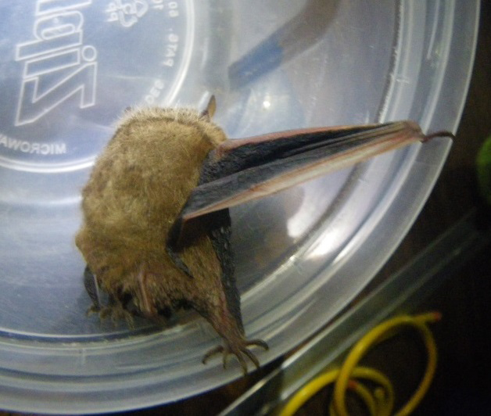
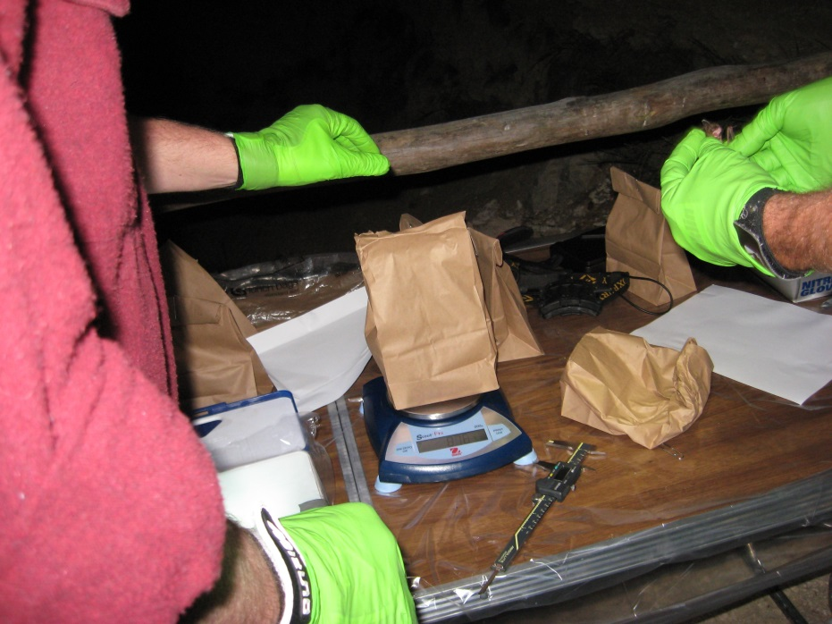
Biometric Measurements – Weighing Bats
Photo © Karen Powers
Photo © Karen Powers
Photo by Commonwealth of Virginia
Notes:
Weighing bats
A bat can be weighed while it’s still in a lunch bag or the bat can be transferred to a plastic container. When you do this step, remember that you need to tare the weight using an empty bag or container first. Bat biologists usually use a pan scale or a spring scale and record the bat’s weight in grams.

Slide 8
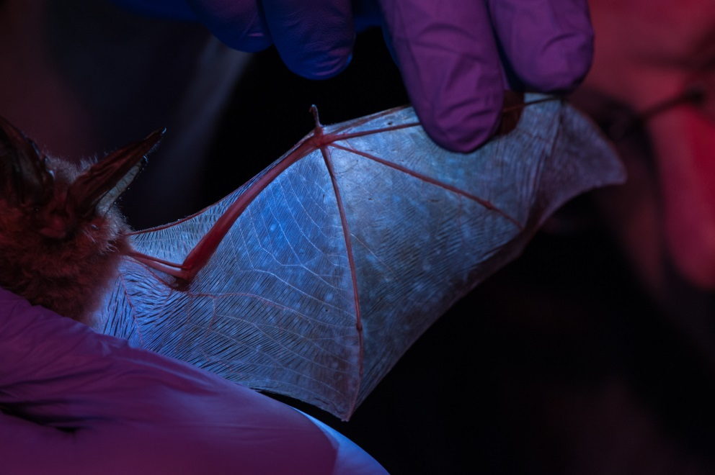
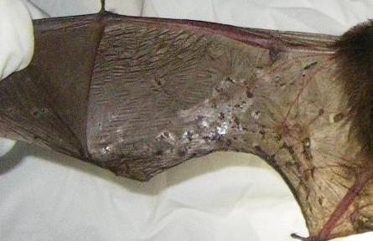
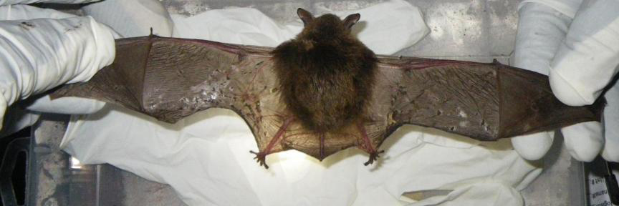
Biometric Clues– Examining Bat Wings
Photo by Tim Jones, U.S. Fish and Wildlife Service
Photo © Karen Powers
Photo © Karen Powers
Notes:
Examining bat wings
Bat wings hold clues about a bat’s health and can sometimes show if the bat has been infected with the fungus that causes White-Nose Syndrome. Bat wings are gently extended and held over a light box for careful examination. Do you see the difference between the healthy bat wing and the damaged bat wing? Sometimes bat biologists even use ultraviolet light to check for White-Nose Syndrome lesions on bat wings. What do you think would happen if a bat’s wing was badly damaged?
The membrane of a bat’s wing is living tissue similar to the tiny flaps of skin joining the bases of our human fingers. Bats have a much larger membrane of skin that joins their long fingers from the bases to the tips. A bat’s fingers cannot flex independently, but the muscles in the arm can open up the hand. Do you think a bat’s wing can heal over time?
Yes, sometimes bats get tears in their wings. A small tear in the wing up to about an inch doesn’t cause the bat much trouble in flight. Since the bat’s wing is living tissue, it can heal itself. But, if the wing is torn too badly, and the bat can't fly, then the bat would not be able to feed itself.
Photos on top right and bottom show a bat that has extreme damage to its wings due to White-Nose Syndrome.

Slide 9
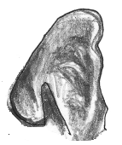
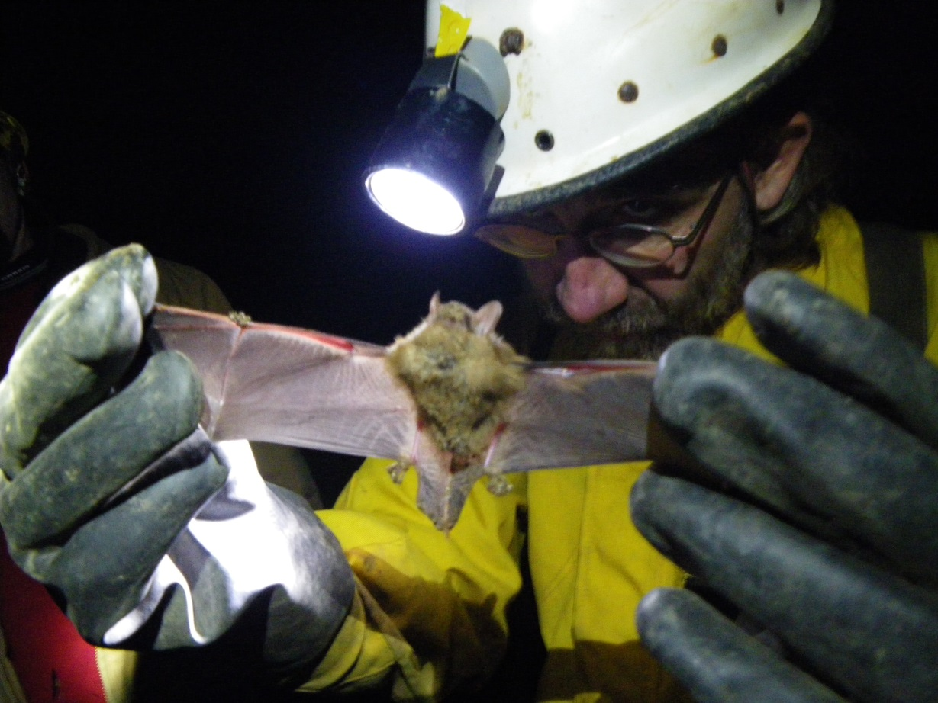
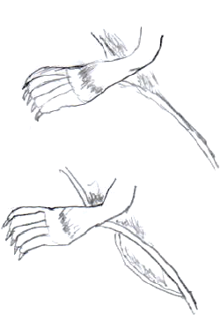
Observing Physical Characteristics
Tragus
Photo © Karen Powers
Keel on Calcar
Notes:
Observing other physical and behavioral characteristics
You might spend a lot of time with your pet cat or dog. You can recognize them instantly! But what if a similar looking animal appeared on your front porch? Would you know if it was really your pet?
Bat biologists also spend a lot of time looking at bats. Sometimes they can instantly recognize a bat’s species. Often it’s more difficult. Scientists look at many physical characteristics to help identify bats. These include: age (juvenile or adult), sex, overall size, fur color, fur length, ear size, tragus size, tail membrane, calcar, and toe hair length. Explain some of the parts of the bat that students might not be familiar with including the tragus, calcar, and tail membrane.
A keeled calcar is a well-defined spur made of cartilage that extends from the ankle towards the tail. It provides support during aerial turns. The tragus is a tiny fingerlike projection of skin-covered cartilage in front of a bat’s ear (after the activity, encourage students to look into the purpose of the tragus). The tail membrane is the skin which joins the legs and/or tail of a bat. The membrane may attach at the ankle or at the toe. All of these characteristics can be important for species identification.

Slide 10
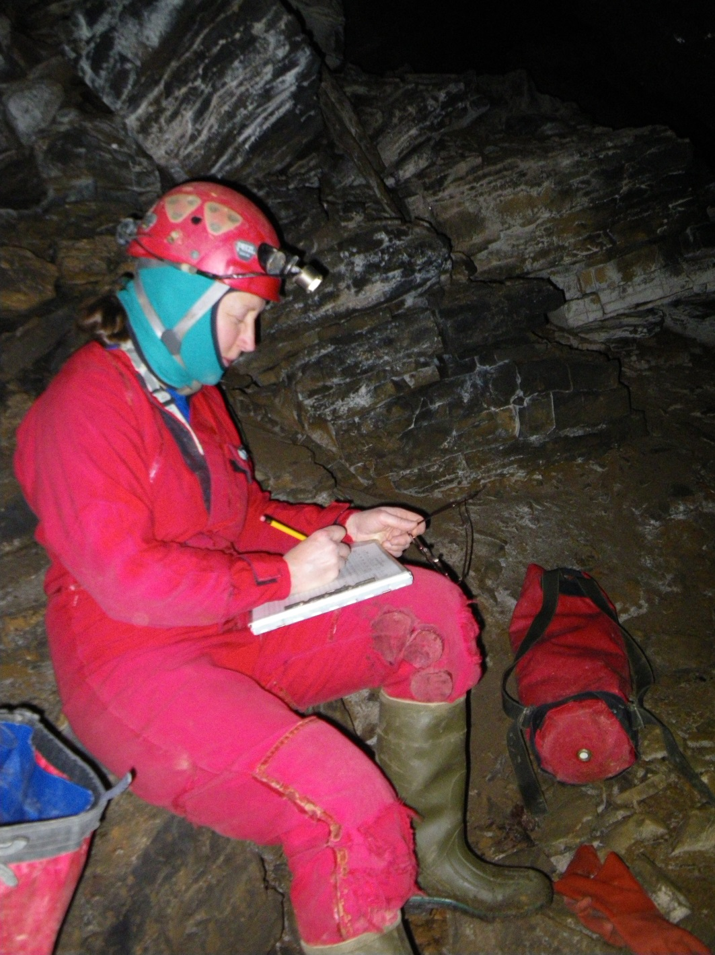
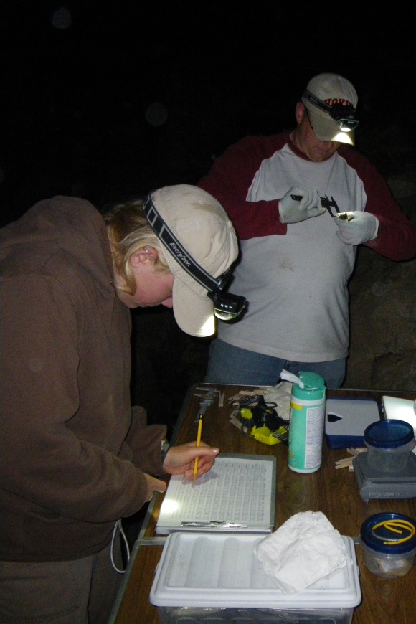
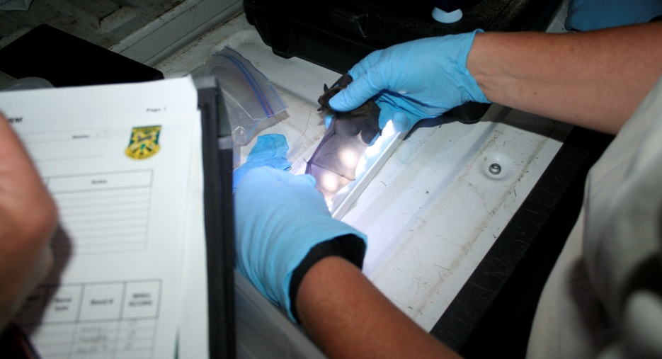
Recording Data
Photo © Karen Powers
Photo © Karen Powers
Photo by U.S. Fish and Wildlife Service
Notes:
Recording data
Now the biologists have all of this information. What do they do with it? First, they need to record it so they can refer to it later. Accurate records are really important for bat surveys. For example, bat biologists might want to compare bats’ weight and health to previous years.

Slide 11
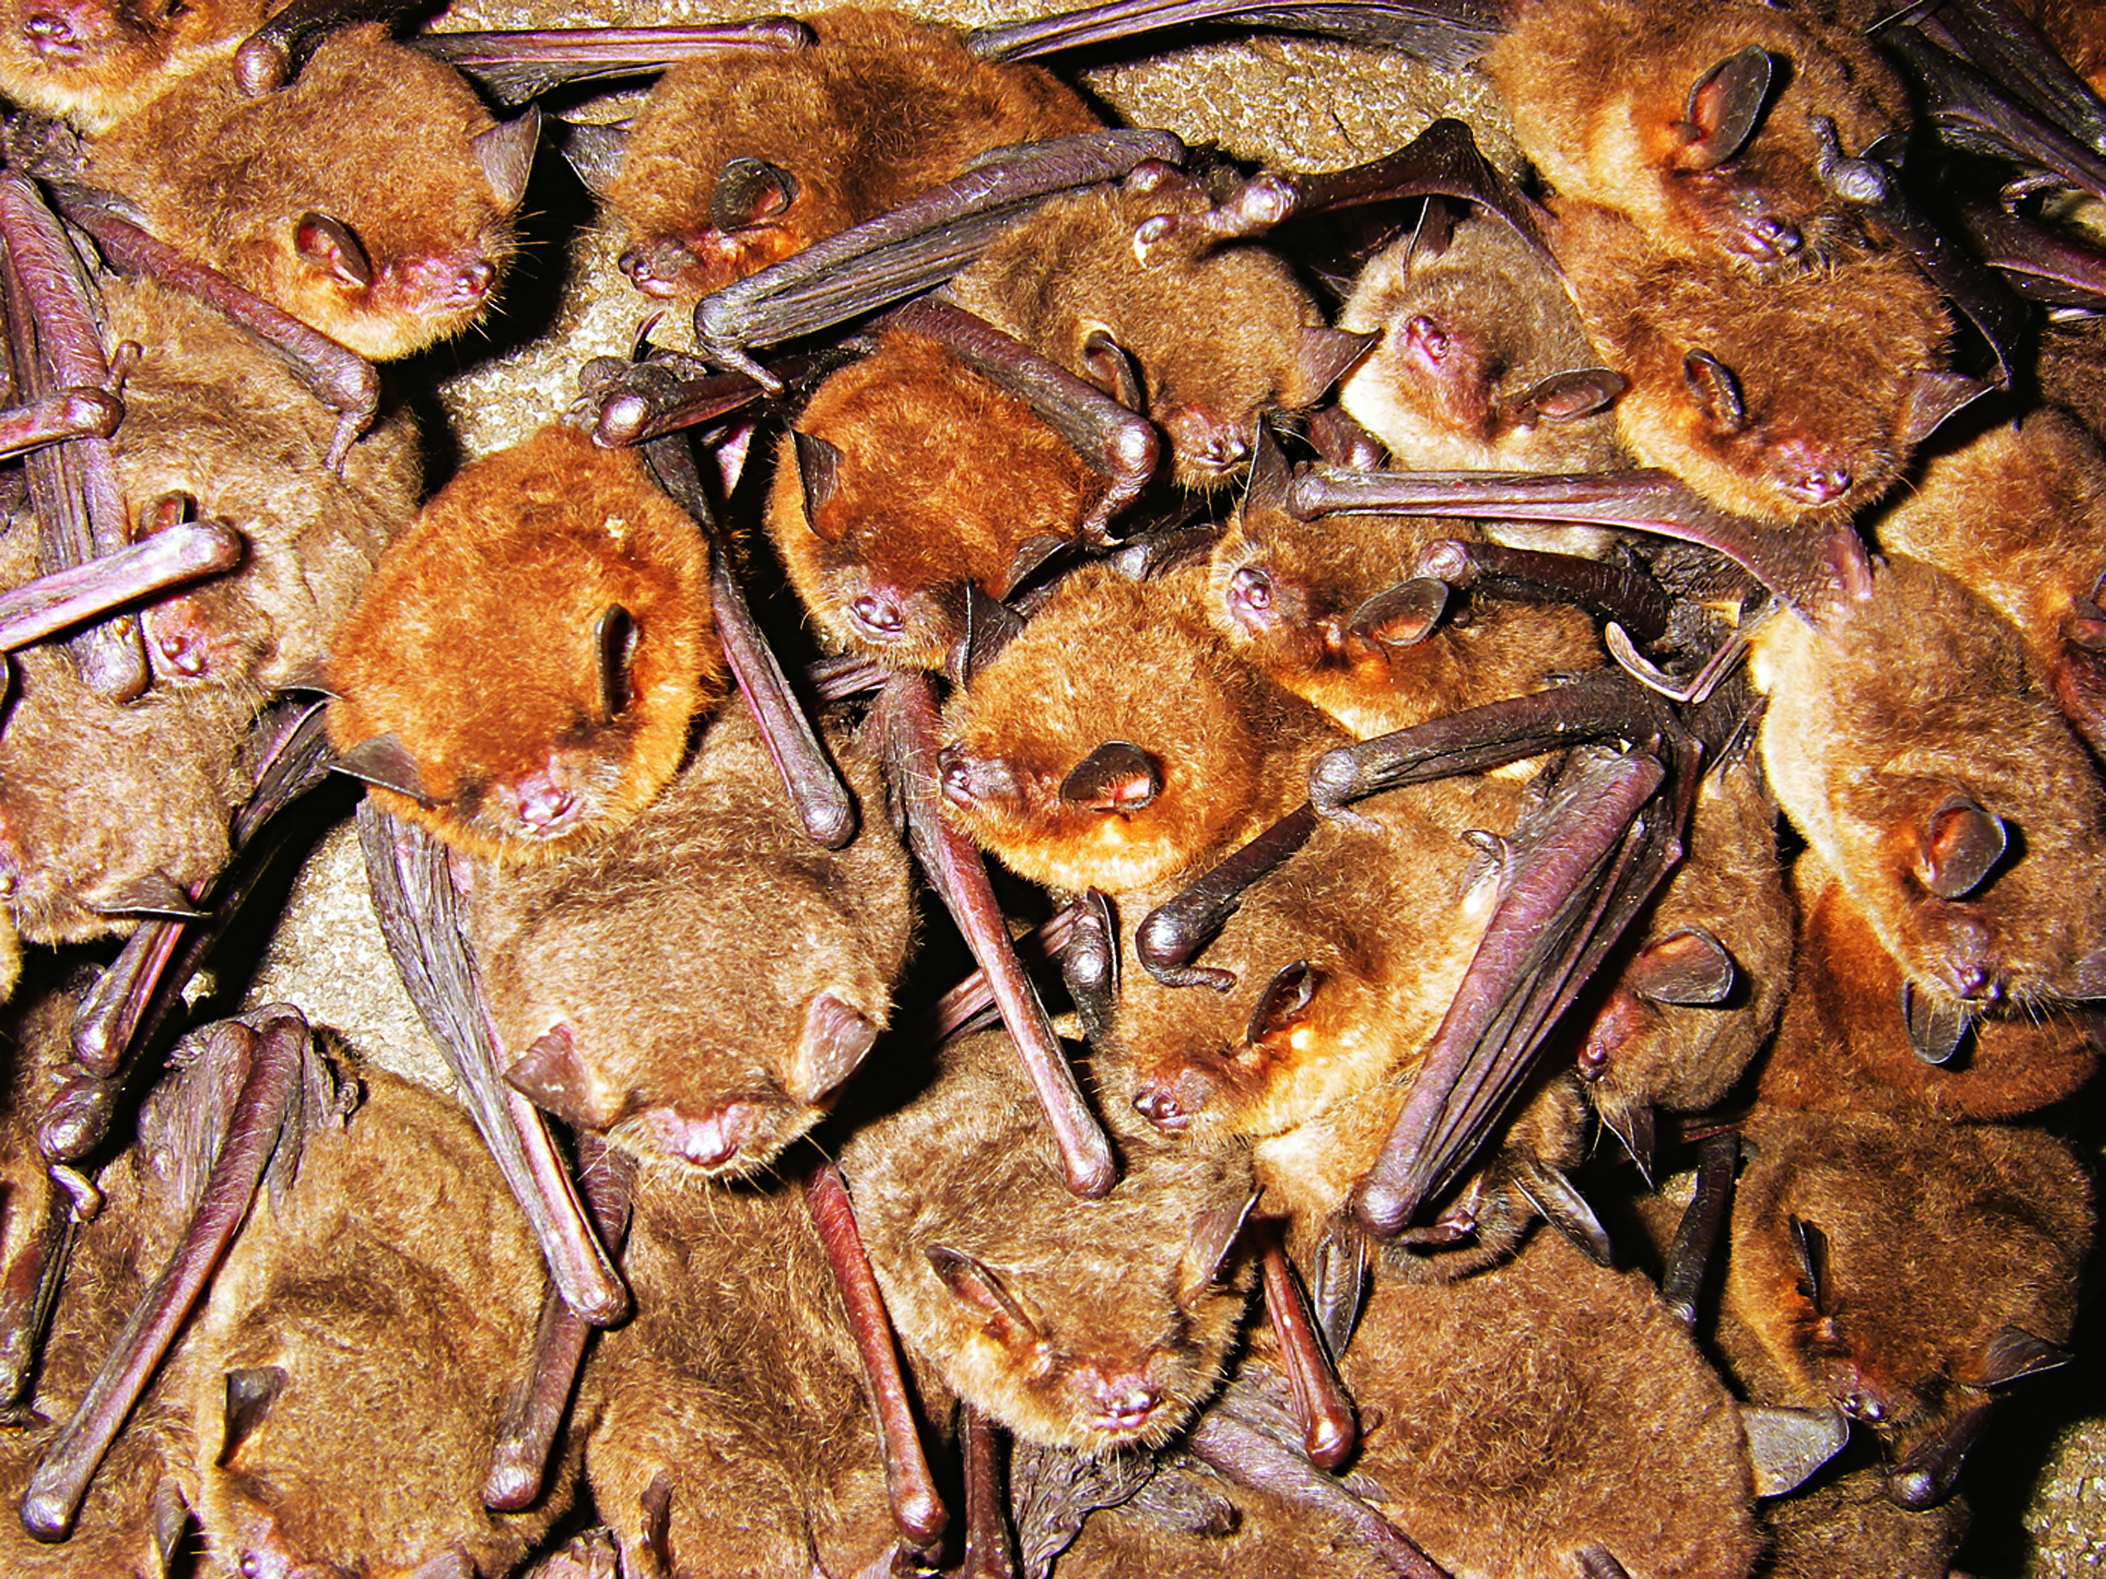
Who Am I? Collecting Your Data:
Date/Time
Weather
Location
Right forearm length
Weight
Physical characteristics
Behavioral characteristics
Photo © Merlin D. Tuttle, Bat Conservation International, www.batcon.org
Photo © Karen Powers
Notes:
Who am I? Today’s activity
You, the bat biologist, will be recording the data that you observe on your Bat Survey Data Form including:
Date
Time
Location
Weather
Weight
Right forearm length
Other Physical characteristics
Behavioral characteristics
You will take this data and use the dichotomous key to be sure to list the evidence that supports your identification of the bat species.
(Top photo is a colony of gray bats clustered in a cave. Bottom photo is a tricolored bat.)

Slide 12
A Special Thanks to Our Photographers
Ann Froschauer, U.S. Fish and Wildlife Service
Tim Jones, U.S. Fish and Wildlife Service
Craig Stihler, West Virginia Division of Natural Resources
Karen Powers, Radford University
Wil Orndorff, Virginia Department of Conservation and Recreation, Natural Heritage Program
Rick Reynolds, Virginia Department of Game and Inland Fisheries

